Slide 1
Visualization
LECTURE 8
Visualizing distributions and KDEs
Data Science, Fall 2023 @ Knowledge Stream
Sana Jabbar

Slide 2
Visualization of Distribution
Regex
Regex review and regex functions
Visualization
Goals of visualization
Visualizing distributions
Kernel density estimation
Lecture 8, Fall 2023

Slide 3
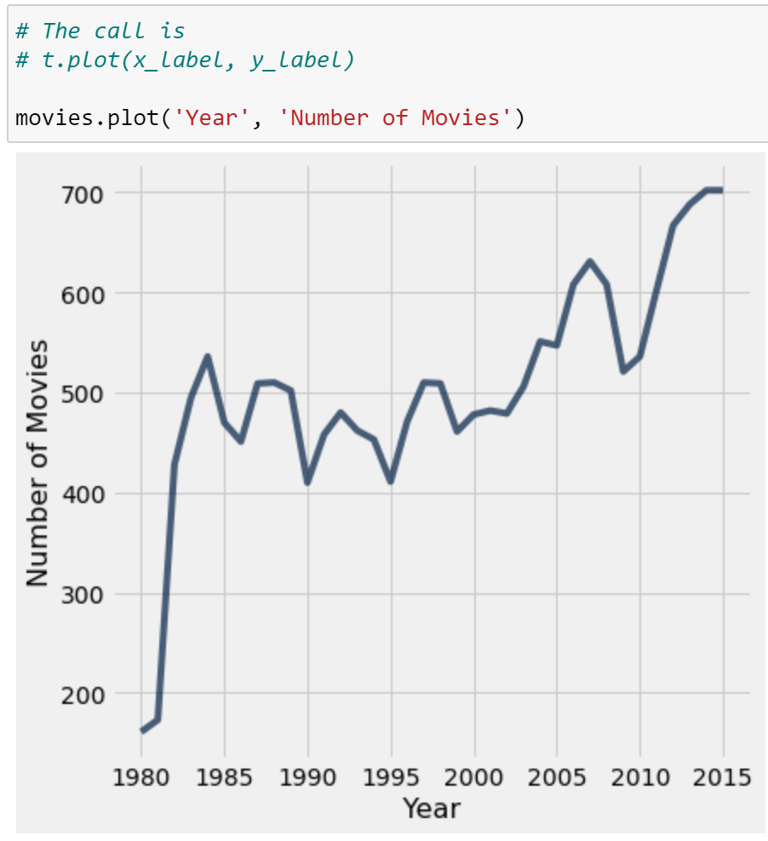
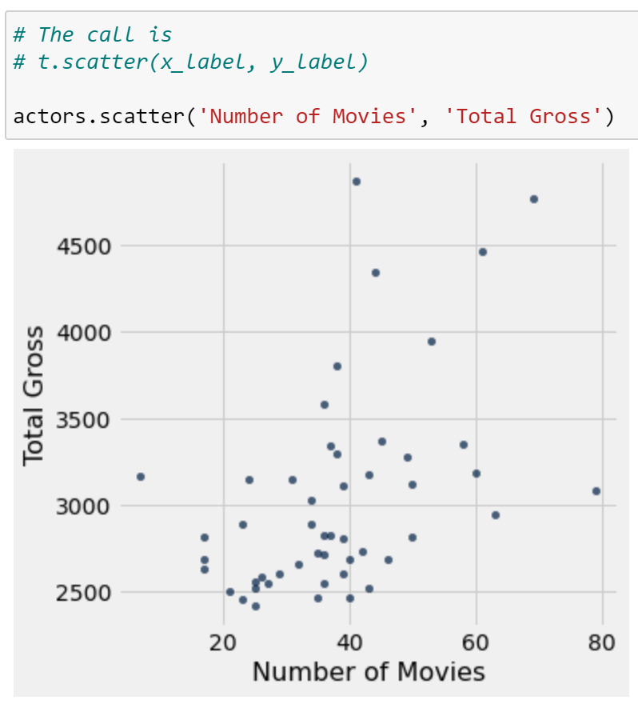
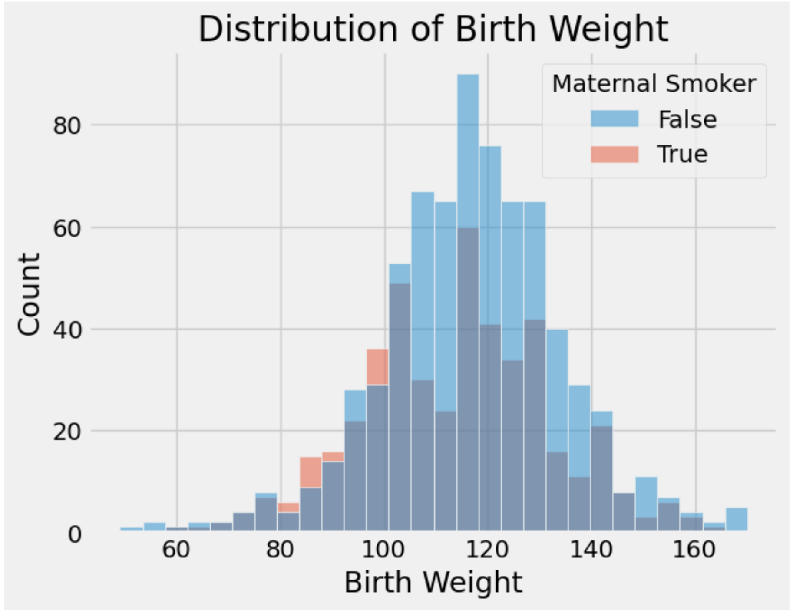
Visualizations in BS (and in Data Science, so far)
You worked with many types of visualizations throughout.
Line plot
Scatter plot
Histogram
What did these achieve?
Provide a high-level overview of a complex dataset.
Communicated trends to viewers.
Notes:
Maps tell one story, time series another.
The importance of one very well-selected metric.
Re-purposing bar charts (great for ranking!) to watch ranks change with time.
Model outputs can be data to be visualized. Data vis can make way for a data dashboard. G

Slide 4
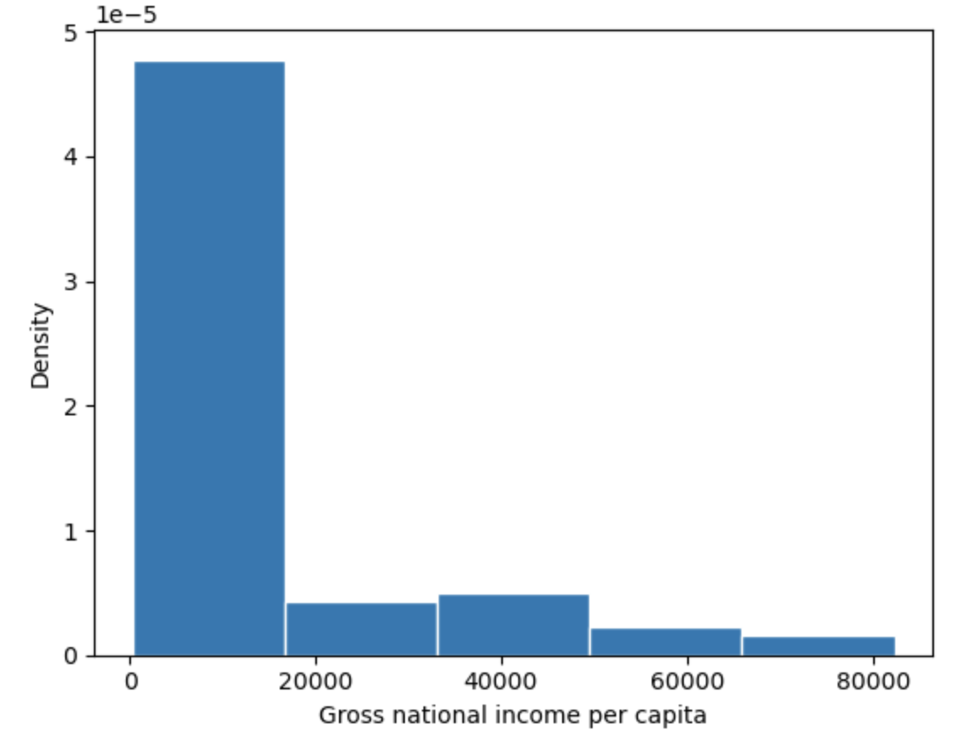
Histograms
A histogram:
Collects datapoints with similar values into a shared "bin".
Scales the bins such that the area of each bin is equal to the percentage of datapoints it contains.
The first bin has a width of $16410
height of 4.77 x 10⁻⁵
This means that it contains 16410 x (4.77 x 10⁻⁵) = 78.3% of all datapoints in the dataset.

Slide 5
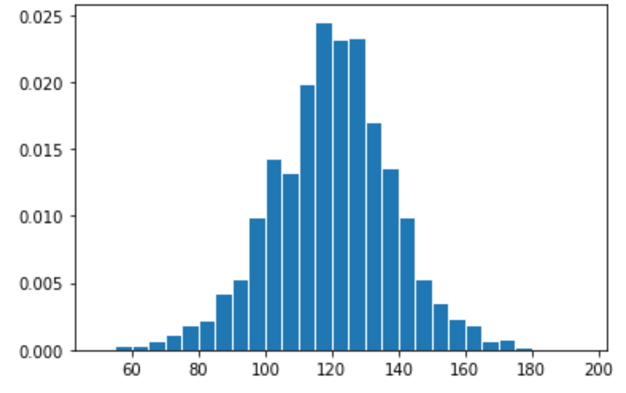
Answer
There are 1174 observations in total.
Width of bin [110, 115): 5
Height of bar [110, 115): 0.02
Proportion in bin = 5 * 0.02 = 0.1
Number in bin = 0.1 * 1174 = 117.4

Slide 6
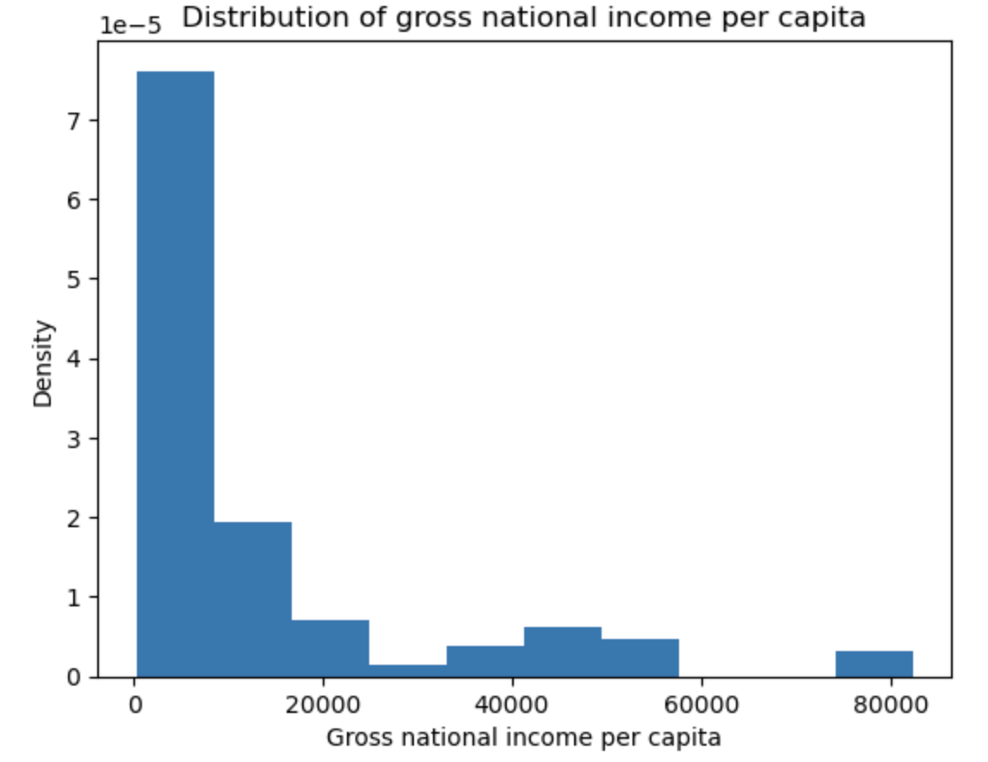
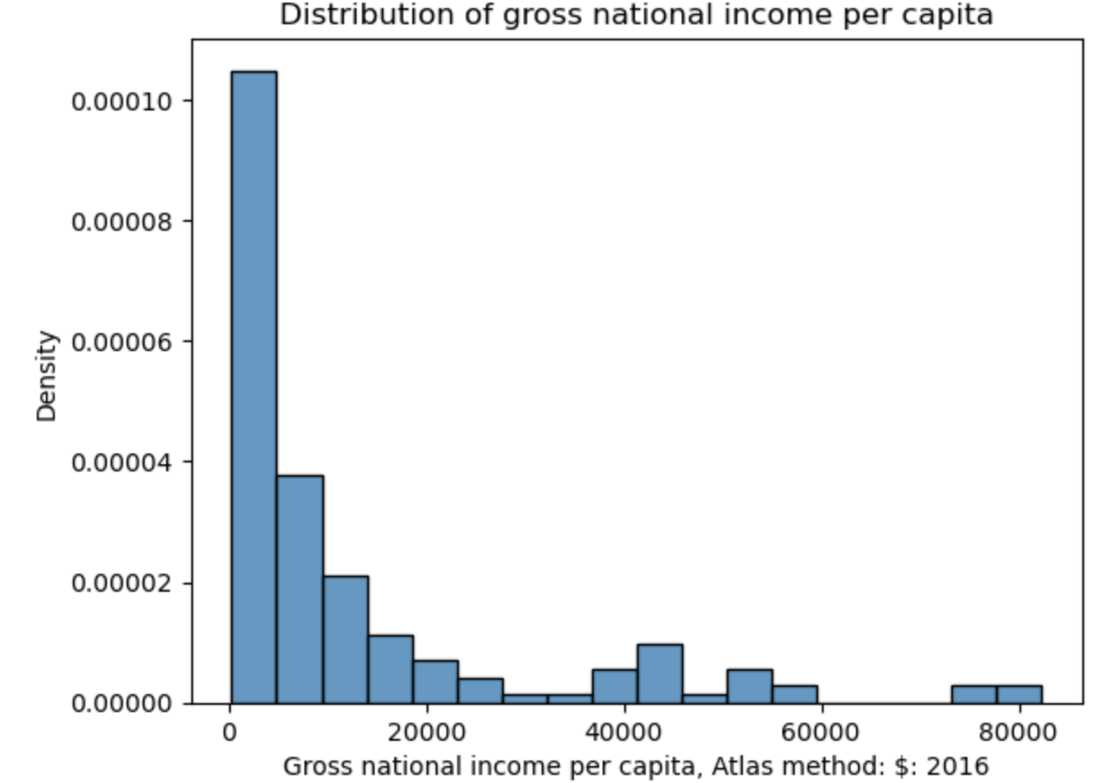
Histograms in Code
In Matplotlib: plt.hist(x_values, density=True)
In Seaborn: sns.histplot(data=df, x="x_column", stat="density")
Matplotlib
Seaborn

Slide 7
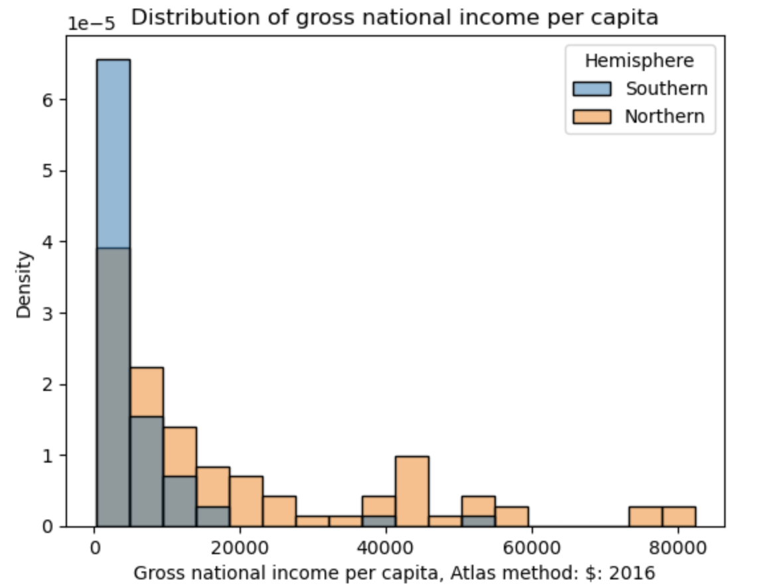
Overlaid Histograms
To compare a quantitative variable's distribution across qualitative categories, overlay histograms on top of one another.
The hue parameter of Seaborn plotting functions sets the column that should be used to determine color.
sns.histplot(data=wb, hue="Hemisphere", x="Gross national income…")
Always include a legend when color is used to encode information!

Slide 8
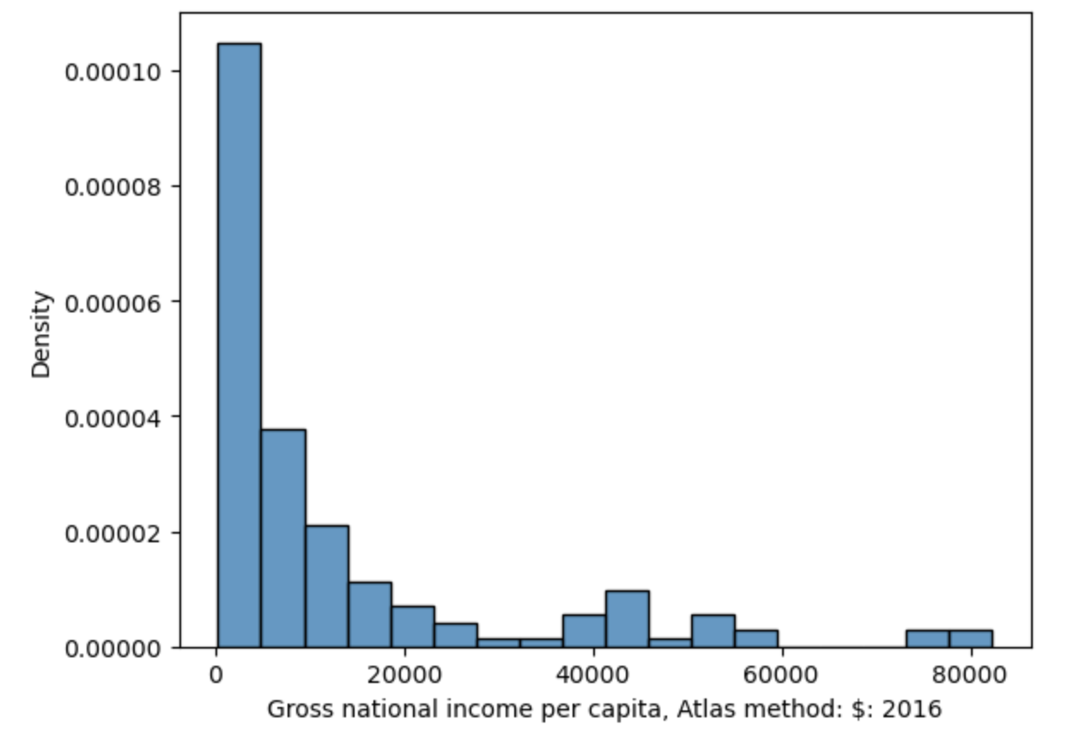
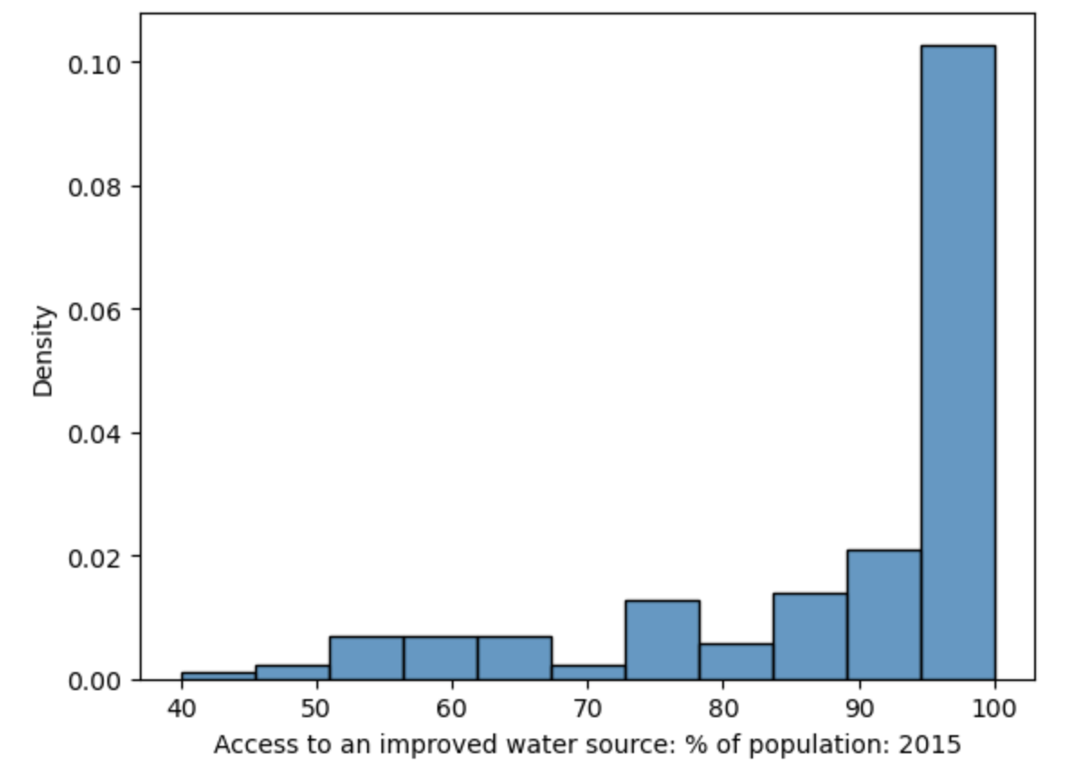
Interpreting Histograms
The skew of a histogram describes the direction in which its "tail" extends.
A distribution with a long right tail is skewed right.
A distribution with a long left tail is skewed left.
A histogram with no clear skew is called symmetric.
A long right tail
A long left tail

Slide 9
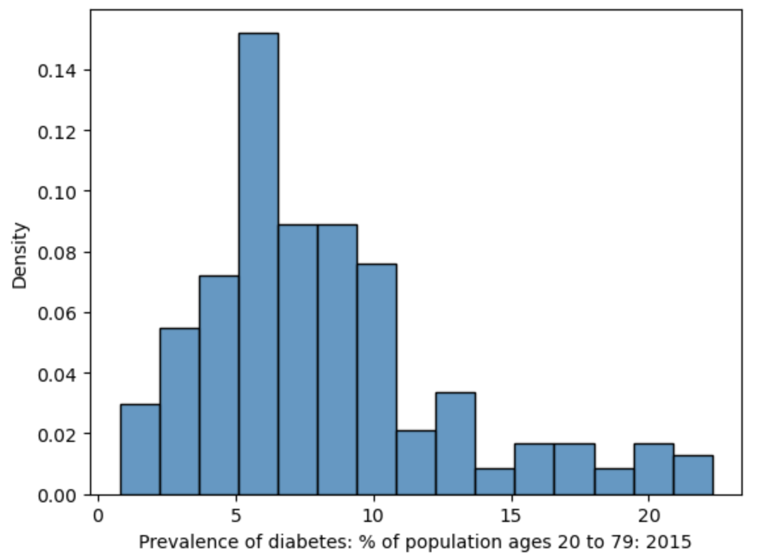
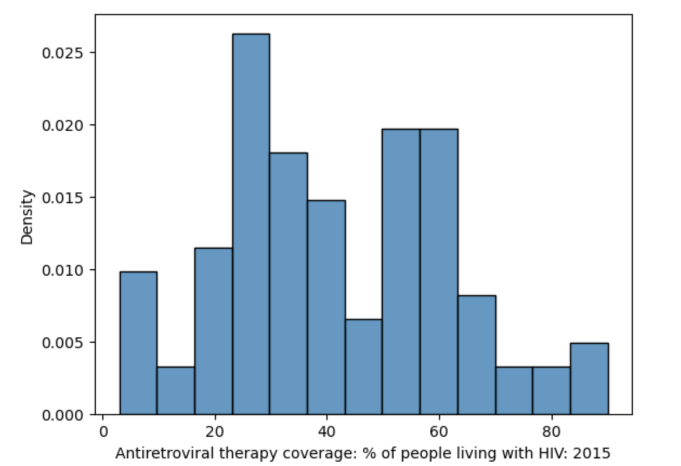
Interpreting Histograms
The mode(s) of a histogram are the peak values in the distribution.
A distribution with one clear peak is called unimodal.
Two peaks: bimodal.
More peaks: multimodal.
Bimodal?
Unimodal

Slide 10
Kernel Density Estimation
Regex
Regex review and regex functions
Visualization
Goals of visualization
Visualizing distributions
Kernel density estimation
Lecture 08

Slide 11
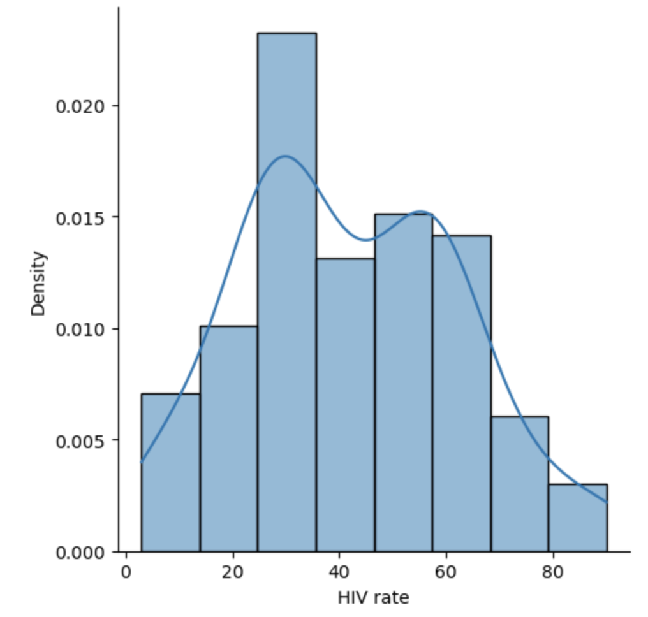
Kernel Density Estimation: Intuition
Often, we want to identify general trends across a distribution, rather than focus on detail. Smoothing a distribution helps generalize the structure of the data and eliminate noise.
A KDE curve
Idea: approximate the probability distribution that generated the data.
Assign an “error range” to each data point in the dataset – if we were to sample the data again, we might get a different value.
Sum up the error ranges of all data points.
Scale the resulting distribution to integrate to 1.

Slide 12
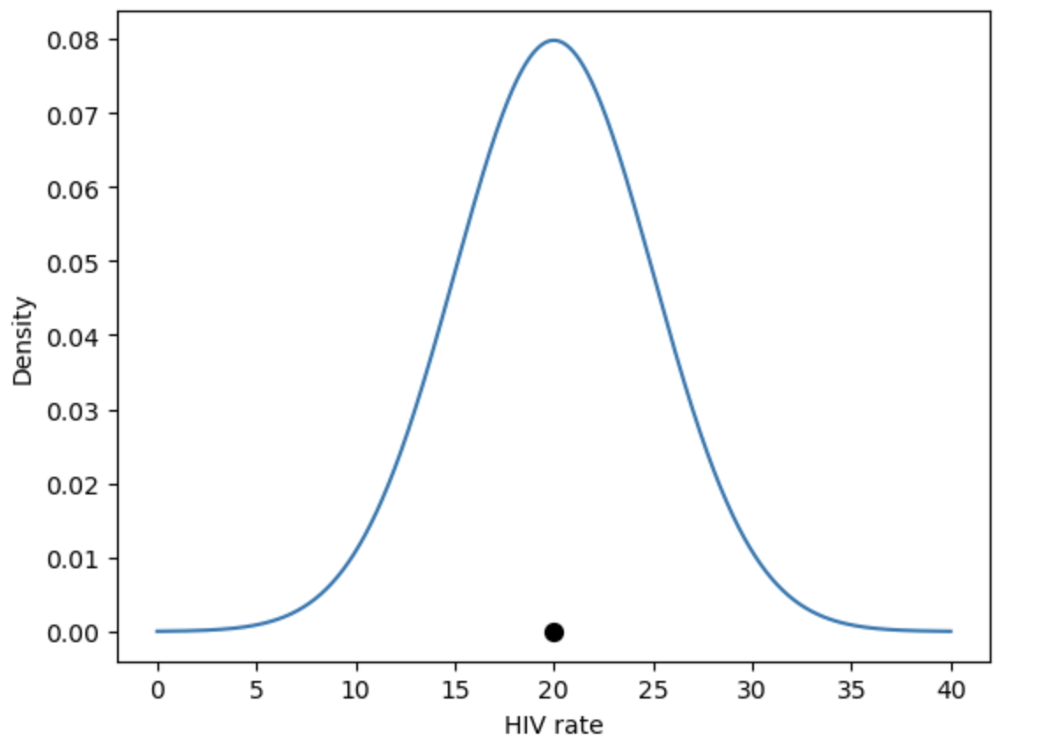
Kernel Density Estimation: Process
Idea: Approximate the probability distribution that generated the data.
Place a kernel at each data point.
Normalize kernels so that total area = 1.
Sum all kernels together.
A kernel is a function that tries to capture the randomness of our sampled data.
The kernel models the probability of sampling that datapoint.
Area below integrates to 1
A datapoint in our dataset

Slide 13
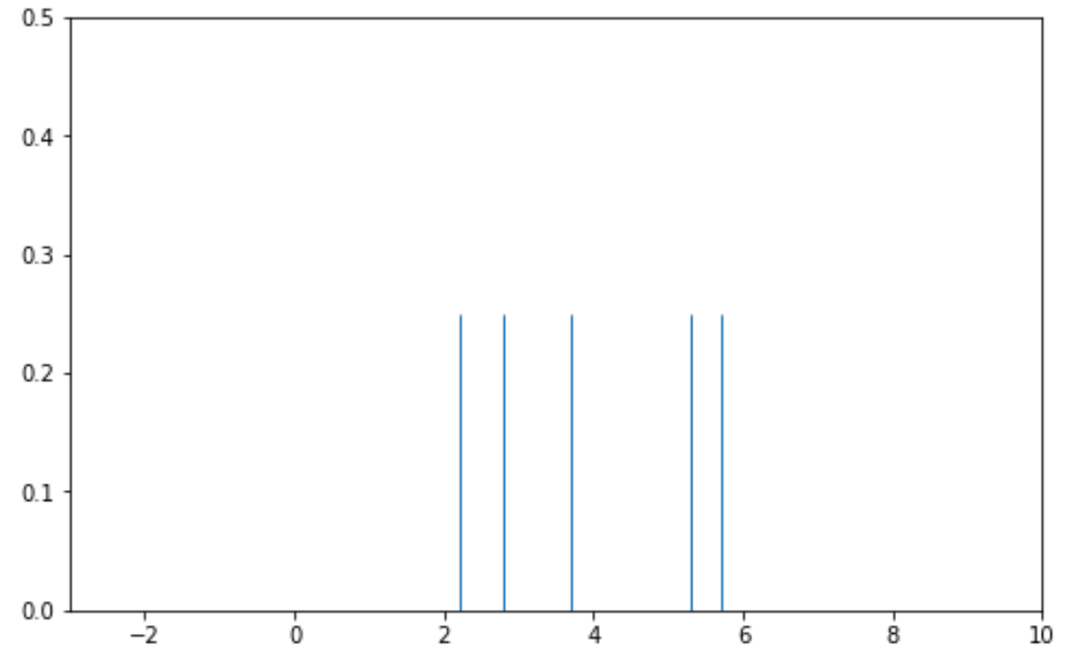
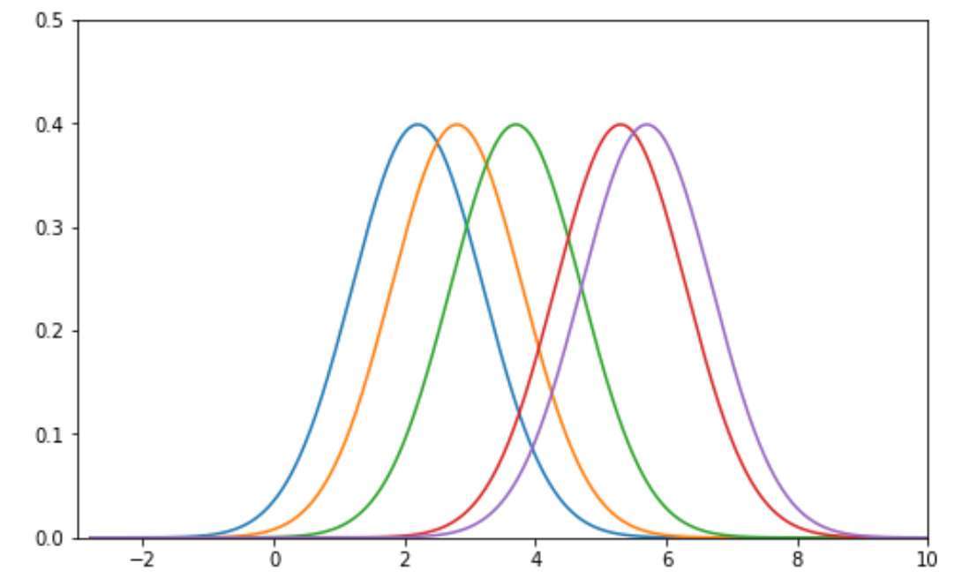
Step 1️⃣ – Place a Kernel at Each Data Point
Consider a fake dataset with just five collected datapoints.
Place a Gaussian kernel with bandwidth of alpha = 1.
We will precisely define both the Gaussian kernel and bandwidth in a few slides.
Each line represents a datapoint in the dataset
(e.g. one country’s HIV rate).
Place a kernel on top of each datapoint.

Slide 14
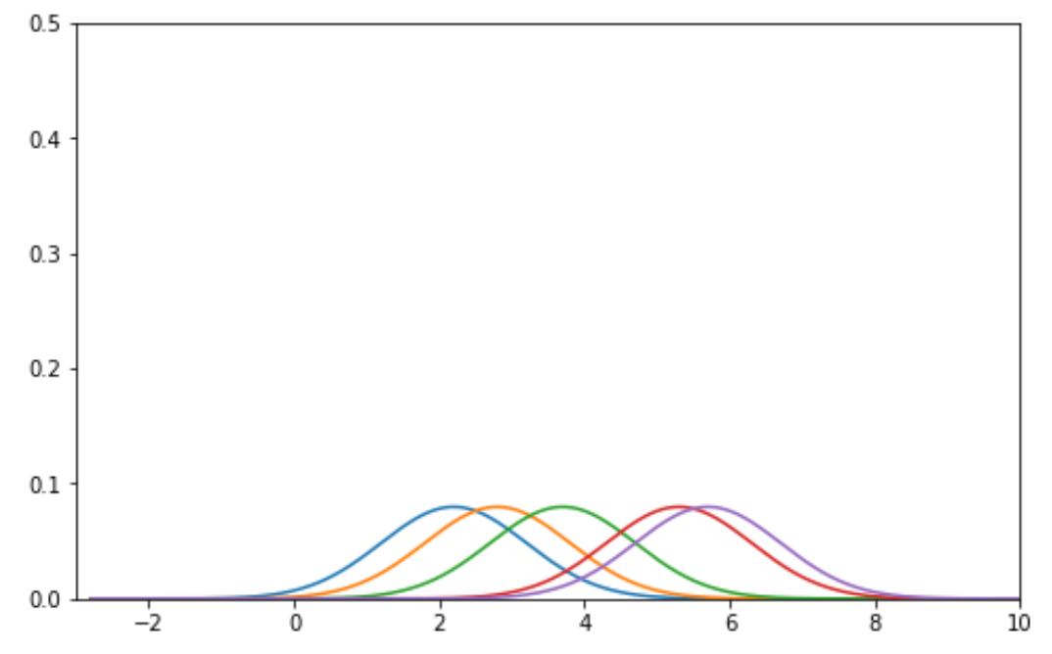
Step 2️⃣ – Normalize Kernels
In Step 3, We will be summing each of these kernels to produce a probability distribution.
We want the result to be a valid probability distribution that has area 1.
We have 5 different kernels, each with an area 1.
So, we normalize by multiplying each kernel by ⅕.
Each kernel has area 1.
Each normalized kernel has density ⅕.

Slide 15
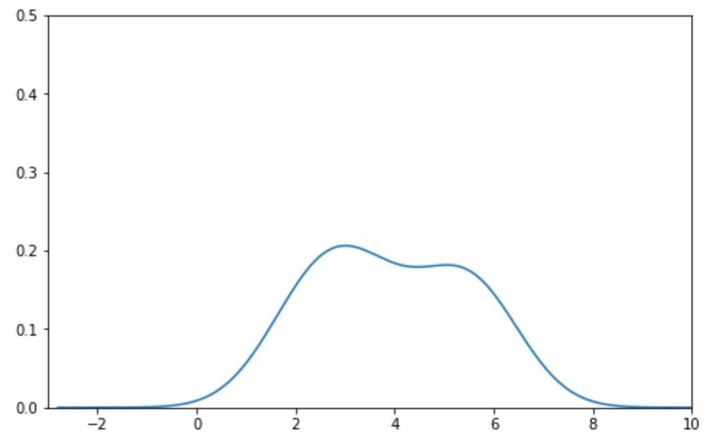
Step 3️⃣ – Sum the Normalized Kernels
At each point in the distribution, add up the values of all kernels. This gives us a smooth curve with area 1 – an approximation of a probability distribution!
Sum these five normalized curves together.
The final KDE curve.

Slide 16
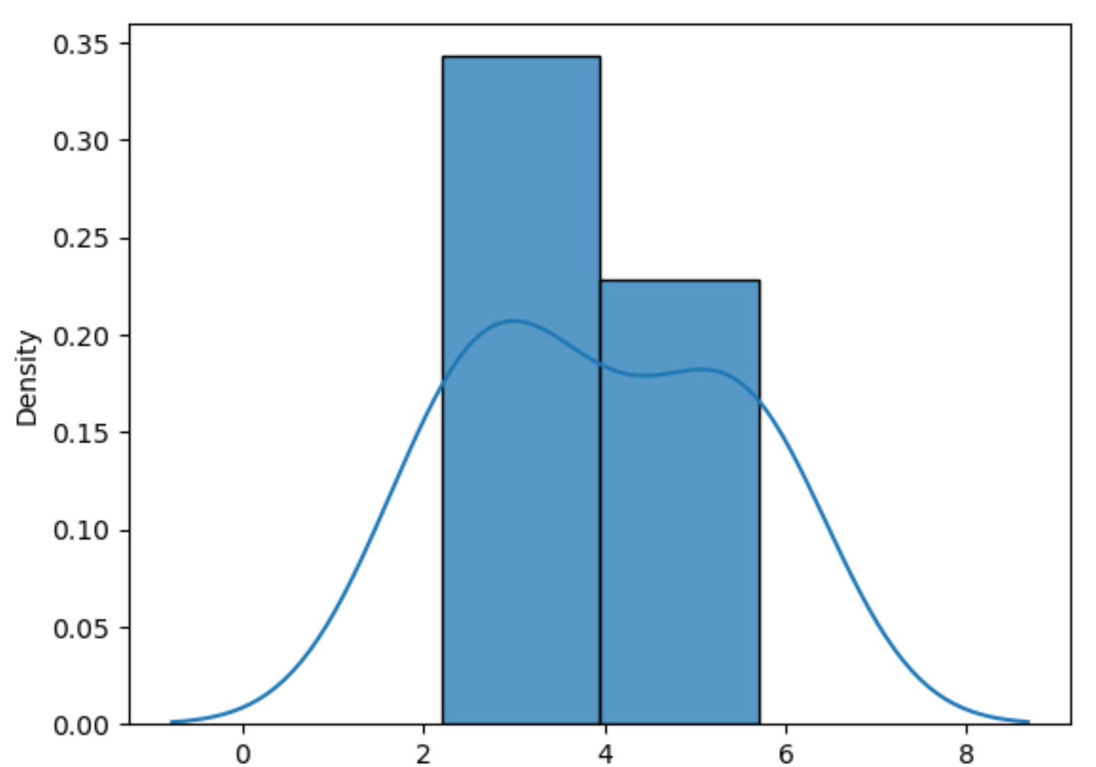
Result
A summary of the distribution using KDE.
Each line represents a datapoint in the dataset
(e.g. one country’s HIV rate).
The density at each point corresponds to the KDE calculated based on kernels placed on all data points

Slide 17
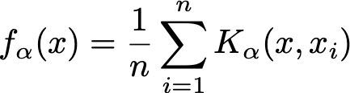
Summary of KDE
2️⃣
3️⃣
K1(x, 2)
K1(x, 6)
1️⃣
A general “KDE formula” function is given above.
K𝝰(x, xi) is the kernel function centered on the observation i.
Each kernel individually has area 1.
K represents our kernel function of choice. We’ll talk about the math of these functions soon.
1️⃣

Slide 18
Summary of KDE
2️⃣
3️⃣
K1(x, 2)
K1(x, 6)
1️⃣
A general “KDE formula” function is given above.
K𝝰(x, xi) is the kernel centered on the observation i.
Each kernel individually has area 1.
x represents any number on the number line. It is the input to our function.
n is the number of observed data points that we have.
We multiply by 1/n to normalize the kernels so that the total area of the KDE is still 1.
Each xi (x1, x2, …, xn) represents an observed data point. We sum the kernels for each datapoint to create the final KDE curve.
𝝰 is the bandwidth or smoothing parameter.
1️⃣
2️⃣
3️⃣

Slide 19

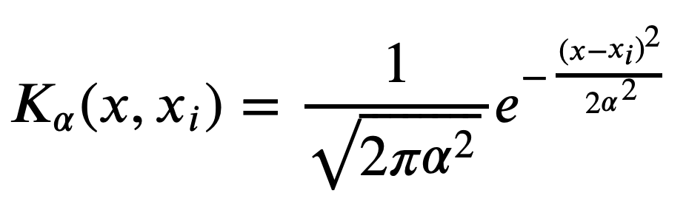
Kernels
A kernel (for our purposes) is a valid density function, meaning:
It must be non-negative for all inputs.
It must integrate to 1(area under curve = 1).
The most common kernel is the Gaussian kernel.
Gaussian = Normal distribution = bell curve.
Here, x represents any input, and xi represents the ith observed value (datapoint).
Each kernel is centered on our observed values (and so its distribution mean is xi).
𝝰 is the bandwidth parameter. It controls the smoothness of our KDE. Here, it is also the standard deviation of the Gaussian.
Memorizing this formula is less important than knowing the shape and how the bandwidth parameter 𝝰 smoothes the KDE.

Slide 20
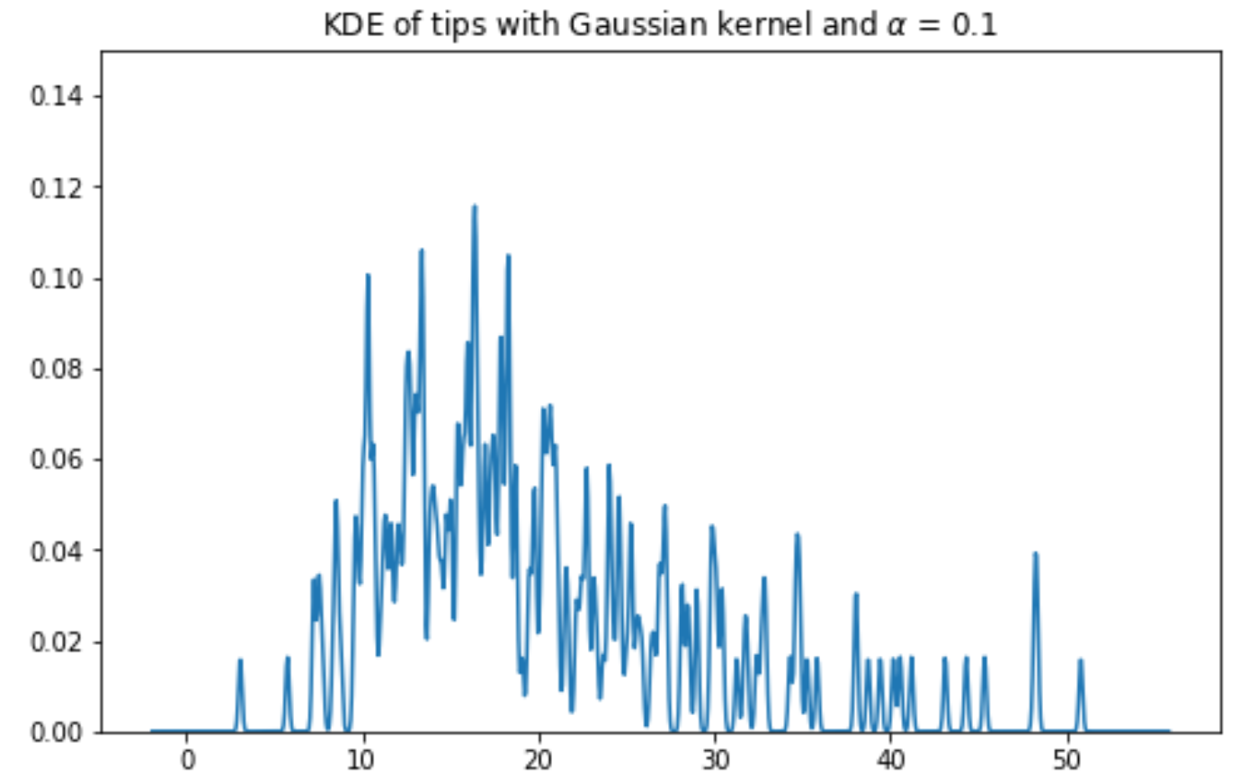
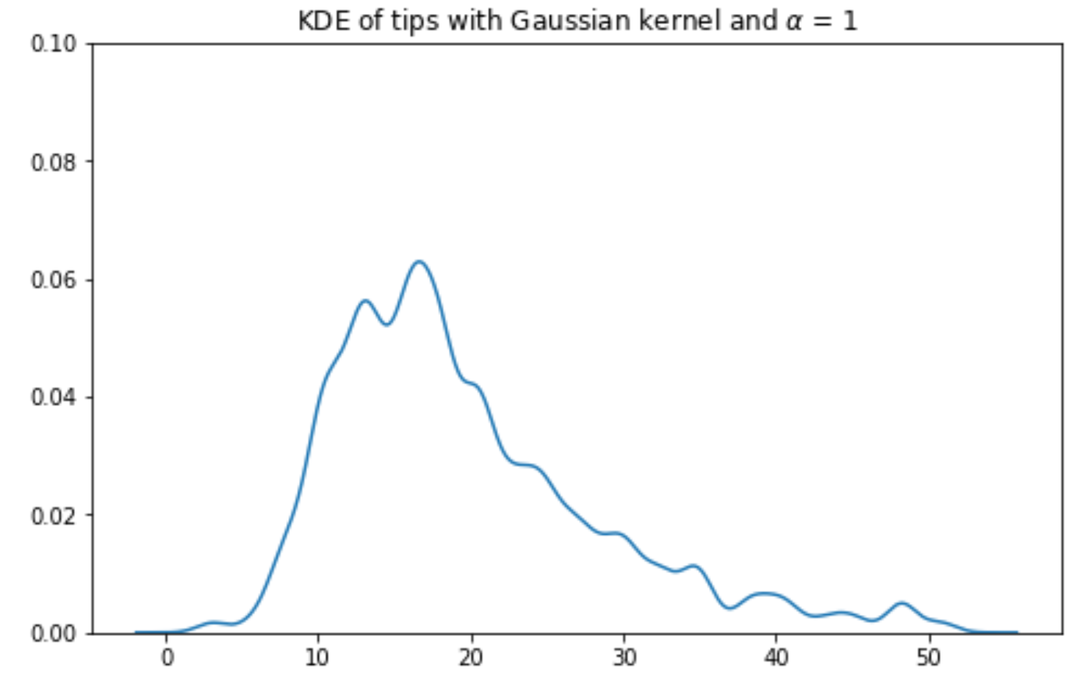
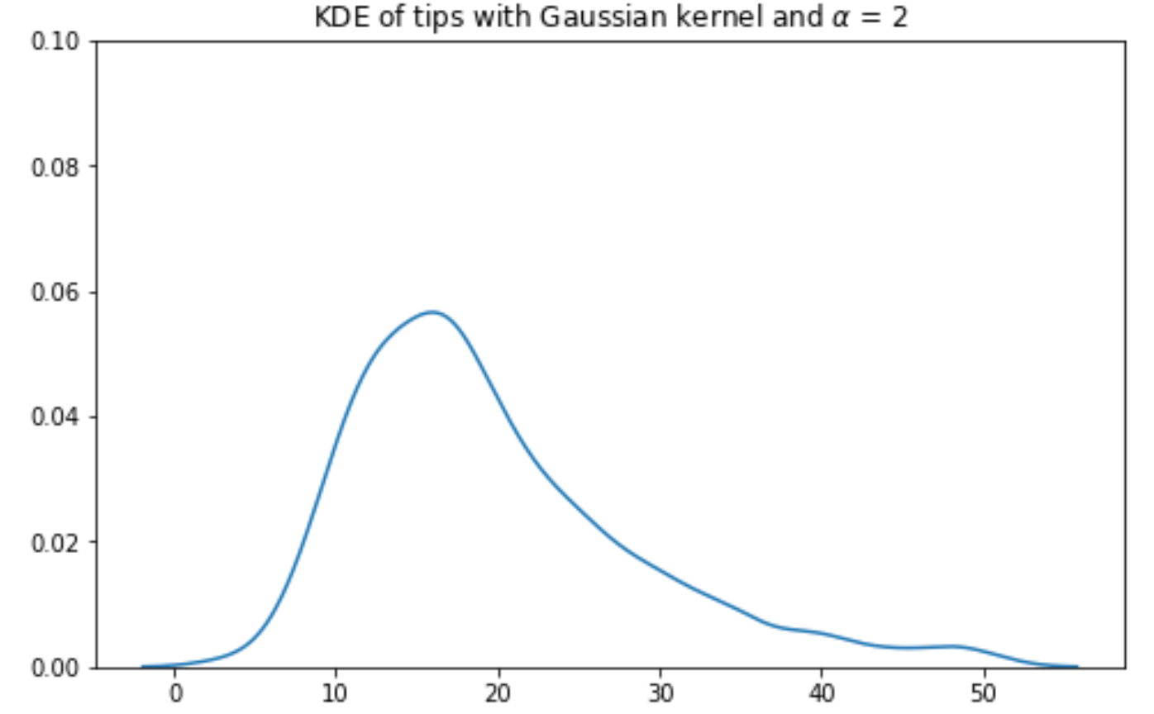
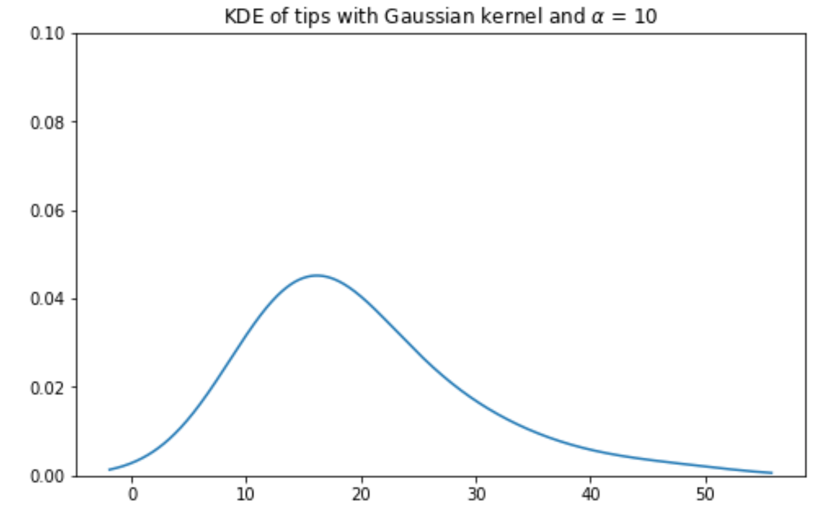
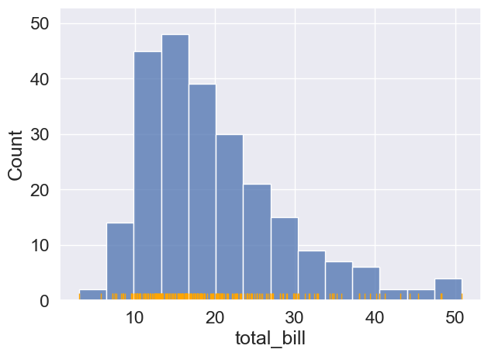
Effect of Bandwidth on KDEs
Bandwidth is analogous to the width of each bin in a histogram.
As 𝝰 increases, the KDE becomes more smooth.
Large 𝝰 KDE is simpler to understand, but gets rid of potentially important distributional information (e.g. multimodality).

Slide 21
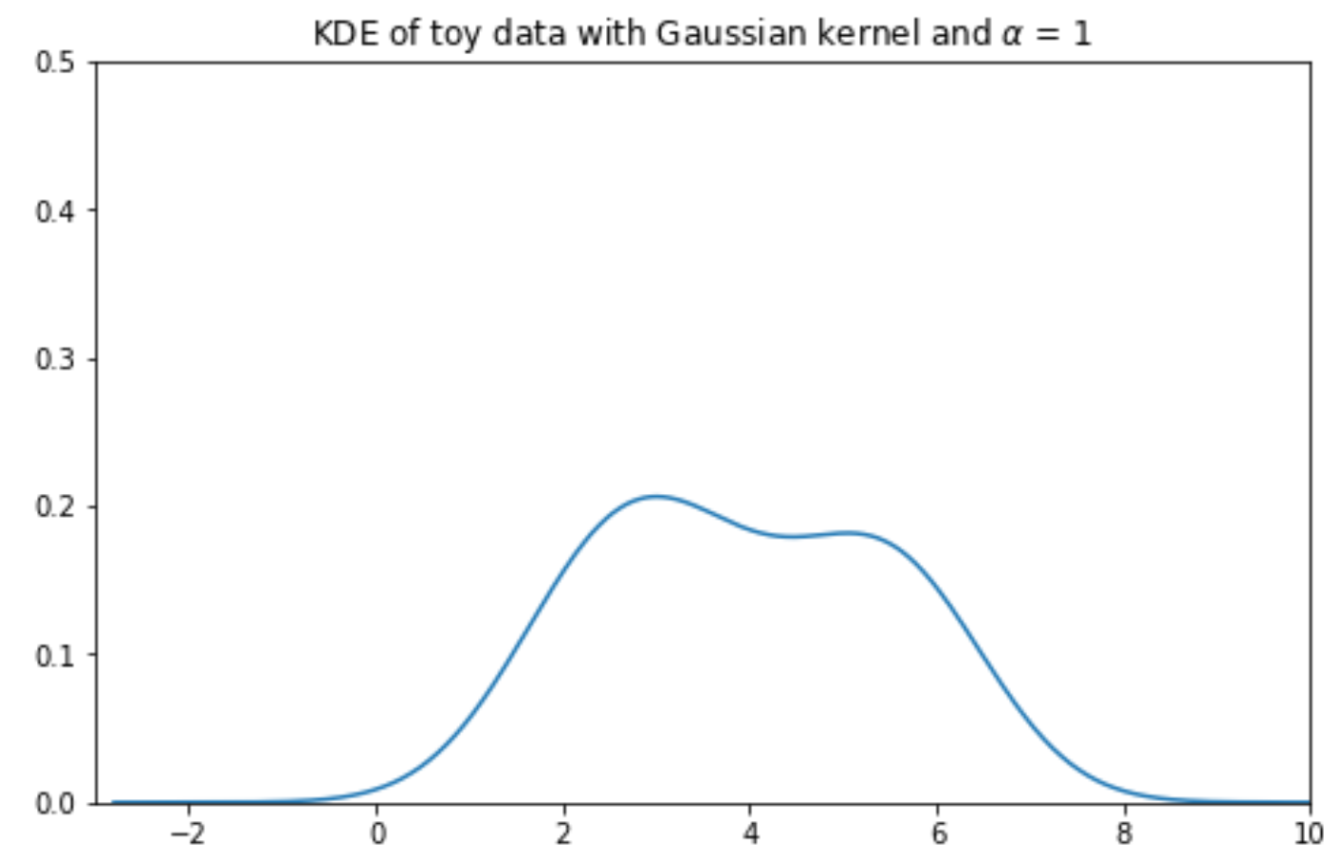
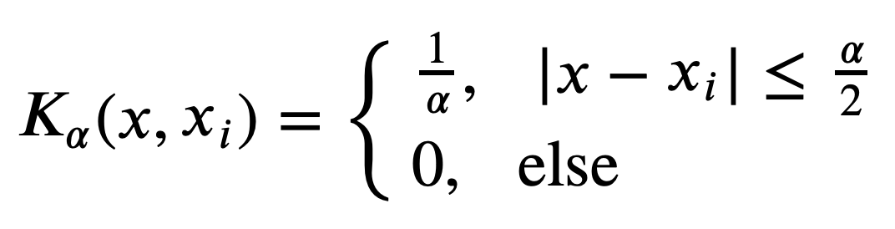
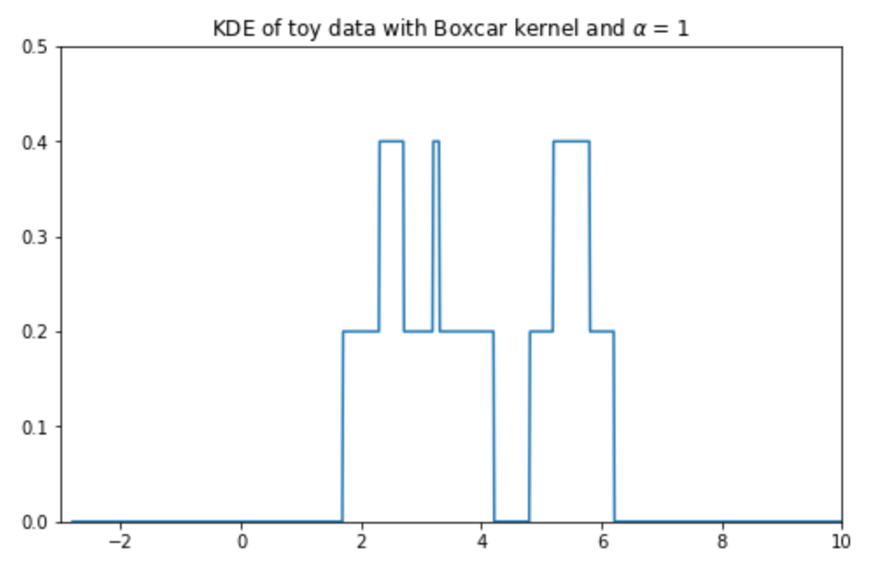
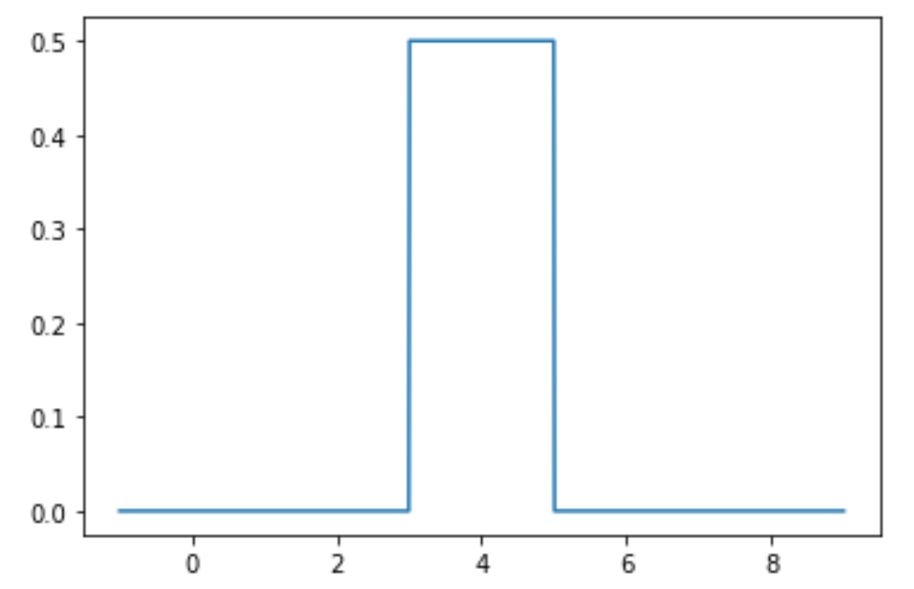
Other Kernels: Boxcar
As an example of another kernel, consider the boxcar kernel.
It assigns uniform density to points within a “window” of the observation, and 0 elsewhere.
Resembles a histogram… sort of.
Not of any practical use in Data 100! Presented as a simple theoretical alternative.
A boxcar kernel centered on xi = 4 with 𝝰 = 2.

Slide 22
Visualization
LECTURE 7
Content credit: Acknowledgments

